Slide 1
Return Journey Home
Dylan Thomas

Slide 2
The blitz…what do you know?
What do you Know? | What do you Want to know? | What have you Learnt?
Task:
Complete the KWL chart.

Slide 3
Background
Return Journey is a radio play.
It was written and broadcast by Dylan Thomas.
It is a moving description of what Thomas encountered when he returned to Swansea from America after the blitz of WW2.
The blitz hit Swansea for three nights in 1941.

Slide 4
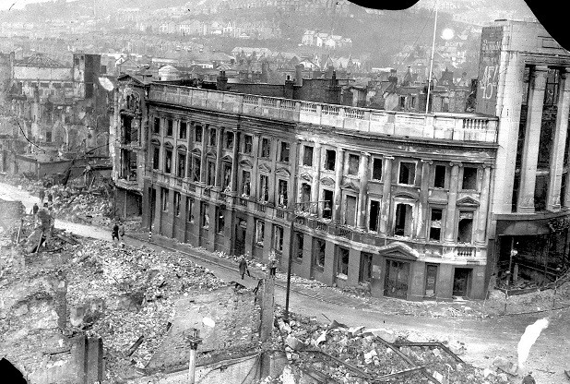

Slide 5
Background
It was a snowy night on the 19th February 1941 when the German Luftwaffe began their three night attack on the coastal town.
Swansea's port area was a major target for the German bombers, as the Nazis looked to hinder coal exports and demoralise residents.
More than 30,000 incendiary bombs and 800 high-explosive bombs rained down on Swansea killing 230 residents, injuring 409 more and destroying or damaging more than 11,000 buildings.

Slide 6
Facts:
Known as Swansea’s bleakest hour. On a cold February night in 1941, a hail of deadly bombs and raging fires ravaged the port town in an attack that still resonates down the decades.
It marked the start of a three-night Nazi attack.
Starting on the night of February 19, the aim of the bombers was to destroy the Swansea Docks and the Victoria railway station. They succeeded in causing devastation to the former centre of the copper industry.
Seven decades on, the statistics of the bombing campaign still have the capacity to chill.
More than 30,000 incendiary bombs were dropped, leaving 575 business premises burnt out, 282 houses demolished and 11,084 damaged.
The human cost was devastating: 227 people were killed, 37 of them under the age of 16. Swansea was left flattened.

Slide 7
Extract from ‘Return Journey’
“It was a cold white day in High Street, and nothing to stop the wind slicing up from the docks, for where the squat and tall shops had shielded the town from the sea lay their blitzed flat graves marbled with snow and headstoned with fences. Dogs, delicate as cats on water, as though they had gloves on their paws, padded over the vanished buildings.”

Slide 8
Task:
On the copy of the extract, annotate it to look at any use of the following:
- links to the events of the blitz
- use of simile
- use of death imagery
- links to place/location

Slide 9
Newspaper Report
What makes an effective news report?
Discuss in pairs and consider aspects such as technique and organisation.
In pairs, look at the exemplar article and annotate evidence of the following:
Who/what is the story is about?
What has happened?
Where did the event take place?
When did it happen?
Why did it happen?
How did it take place?

Slide 11
Newspaper Name

Slide 12
Newspaper Name
Headline

Slide 13
Newspaper Name
Headline
Sub-Heading

Slide 14
Newspaper Name
Headline
Sub-Heading
Column

Slide 15
Newspaper Name
Headline
Sub-Heading
Column
Additional Headline

Slide 16
Newspaper Name
Headline
Sub-Heading
Picture
Column
Additional Heading

Slide 17
Newspaper Name
Headline
Sub-Heading
Picture
Column
Caption
Additional Heading

Slide 18
Newspaper Name
Headline
Sub-Heading
Picture
Column
Caption
Additional Heading
Advert

Slide 19
In pairs: Complete the following planning sheet in preparation for your writing task

Slide 20
Writing Task: Using the facts that you have been given, along with Dylan Thomas’s description of Swansea on his return, write a newspaper report detailing the events as though they had just occurred.

Slide 21
Return to your KWL charts and note down what you feel you have now learnt.

